Slide 1
STAFF EVENT PLANNER
GROUP NO :06
ROLL NO
36
41
38
37
22
USN
3BR23CA084
3BR23CA089
3BR23CA086
3BR23CA085
3BR23CA068
NAME
RISHI RAJ SHARMA
S MADAN
S ASIF HUSSAIN
RUHI NAZ NS
MIZBA

Slide 2
CONTENTS
ABSTRACT
OBJECTIVE
PROBLEM STATEMENT
PROJECT OVERVIEW
TECHNOLOGY USED
SYSTEM WORKFLOW
CONCLUSION

Slide 3
ABSTRACT
The *Event Staff Management System* is a Python-based project designed to efficiently manage staff for events. It allows registration, role assignments, and scheduling of staff members. The system tracks availability, automates notifications, and generates reports. A database securely stores staff information for easy access and updates. It reduces manual effort, enhances coordination, and adapts to events of different sizes. This project aims to streamline staff management for successful event execution.

Slide 4
OBJECTIVE
*Database Creation and Connectivity*: Establishes a connection with a MySQL database and creates a new database and table to store employee information if they don't exist.
*Employee Data Management*: Allows the user to add, display, delete, and modify employee records, such as employee number, name, job position, and salary details.
*Salary Slip Generation*: Displays payroll information and generates detailed salary slips for all employees or a specific employee.
4. *User-friendly Interface*: Provides a menu-driven interface to interact with the database, perform various operations on employee records, and exit the system.

Slide 5
PROBLEM STATEMENT
Event organizers face difficulties managing staff, resulting in scheduling conflicts and miscommunication, which can affect event success. An automated system is needed to streamline staff scheduling and coordination. This solution should provide real-time updates to ensure smooth event operations.

Slide 6
PROJECT OVERVIEW
Key features of the project include:
Database management
Employee Record Operation
Salary calculation
Payroll and salary slip
Interactive menu

Slide 7
TECHNOLOGY USED
The Event staff planner program leverages several technologies and programming concepts to ensure efficient management of athlete profiles and their championship records:
Python Programming Language
Exception handling
Python and mysql connectivity
Tabulate and datetime modules

Slide 8
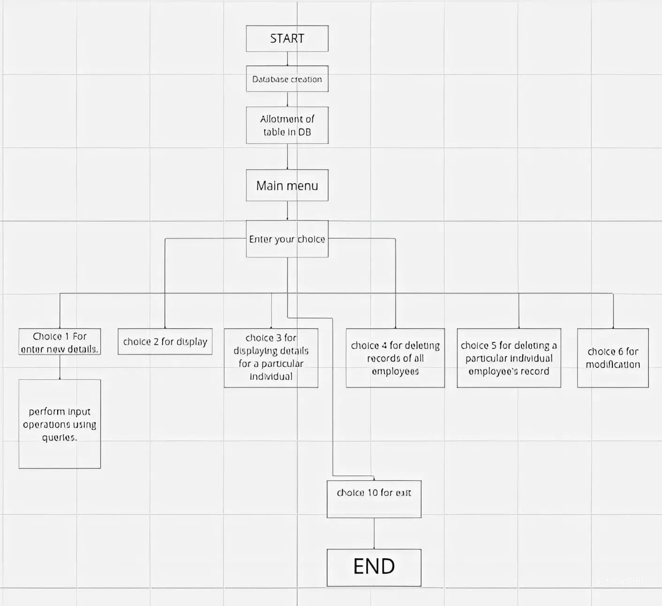
SYSTEM WORKFLOW

Slide 9
CONCLUSION
The development and implementation of the Employee Event Management System have proven to be a valuable asset to the organization. The system has successfully automated critical event management tasks, enhancing efficiency, collaboration, and event tracking capabilities.
The system's user-friendly interface, comprehensive features, and integration with Python and MySQL database have made it a valuable tool for organizing and managing successful employee events. The positive results, including improved planning efficiency, increased event attendance, and enhanced feedback mechanisms, demonstrate the system's impact on fostering a positive and engaging work environment.
Our system provides a solid foundation for future enhancements and expansion, allowing for customization and integration with other organizational systems.
Enhanced user interface
Integration with other systems
Advanced Analytics

Slide 10
Q & A
THANK YOU
TEAM:06

